Slide 1

AIR CONDITIONING CLEANING
Split systems
Ducted
In window units
HVACR
Refrigerators

Slide 2
Air con
Developed in 1902 by Willis Haviland Carrier
Designed to solve a humidity problem in a publishing company in Brooklyn, NY.
An air conditioner is very similar to another appliance in your home – the refrigerator. Air conditioners don't have the exterior housing a refrigerator relies on to insulate its cold box. Instead, the walls in your home keep cold air in and hot air out.

Slide 3
Types of Air con units
Split systems
Window units
Ducted systems
HVACR
Refrigerators
Cool Rooms

Slide 4
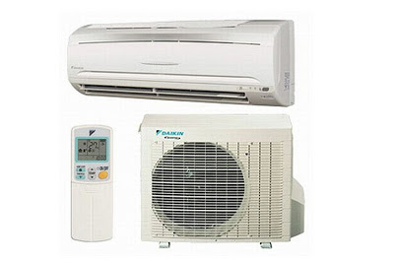
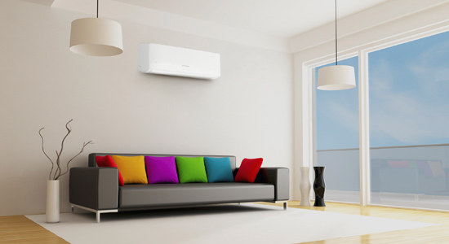
Split Systems
Ideal for air conditioning one room or a specific area of a home.
Wall-mounted
Less expensive to install than a ducted system and typically cheaper to run

Slide 5
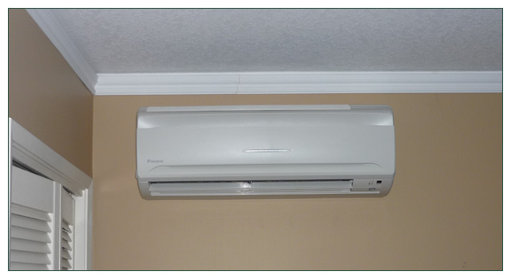
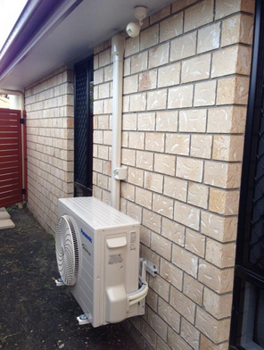
The split system breaks the air conditioning system into 2 packages or terminal units
evaporative unit (internal unit)– located inside the house and handles air cooling and distribution.
condensing unit (external unit) - installed outside of the house and contains the compressor which is linked to the internal unit via drain pipes and electric cables.

Slide 6
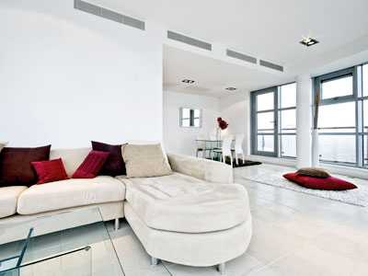
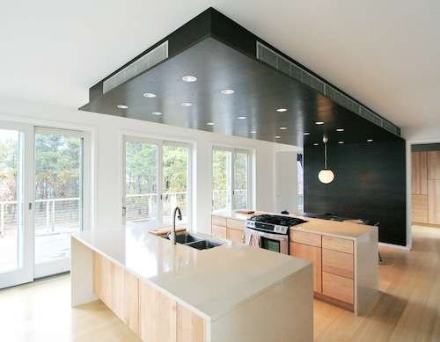
Ducted systems
Operates from a central location and warm or cool air is sent to the various rooms of the house via a network of ducts.
ducts are hidden in the wall and roof and only discreet wall and roof panels are visible.
more expensive than a split system.

Slide 7
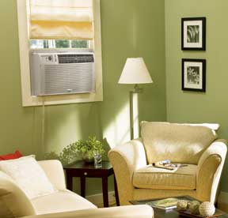
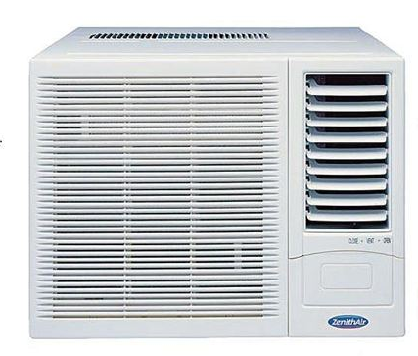
Window Unit
designed to be fitted in window sills.
houses all the necessary components, namely the compressor, condenser, expansion valve or coil, evaporator and cooling coil enclosed in a single box.

Slide 8
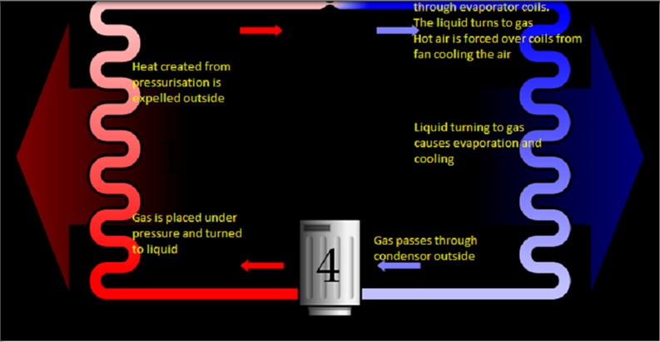
Simplified explanation of how an air con works

Slide 9
How an Air con works?
Air conditioners use refrigeration to chill indoor air,
Taking advantage of a remarkable physical law: When a liquid converts to a gas (in a process called phase conversion), it absorbs heat. Air conditioners exploit this feature of phase conversion by forcing special chemical compounds to evaporate and condense over and over again in a closed system of coils.
The liquid evaporates in the internal or Evaporative unit and turn the gas back into a liquid or condenses in the condenser

Slide 10
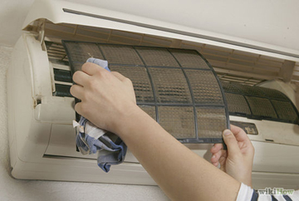
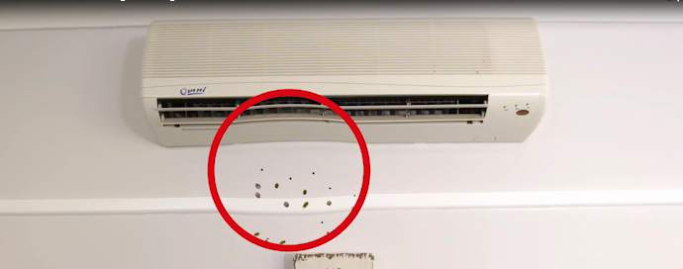
What reduces the efficiency of an Air Con?
Over time, the moisture from the air-con unit attracts mould, dirt germs and bacteria
This build up reduces the exposed areas on the coil used for cooling and restricts airflow, meaning the motors have to work harder to deliver the desired temperature.

Slide 11
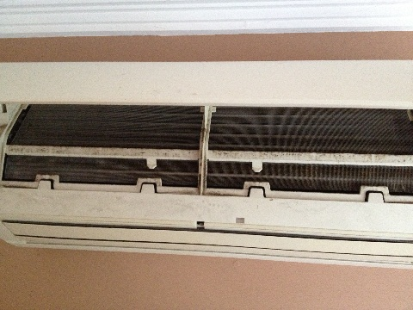
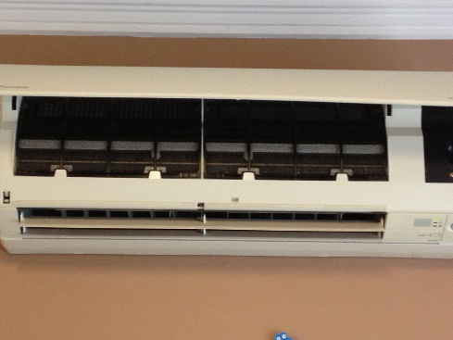
Benefits of an Air Conditioner Clean
Cleaner and fresher air
Improve air quality by removing allergens which are blown through your home
Saves up to 22% on electricity cost of the running cost of the unit
Improve airflow which means more effective cooling or heating.
Reduced maintenance of the machine
Extends the life of your air conditioner filter
The cleaning will last for 3-6 months (EcoProtect, 24 months)
Before
After

Slide 12
How do we save electricity?
If an air con works more efficiently, it will bring a desired room to its desired temperature faster and the thermostat will turn the machine off.
While the machine is off, it consumes less electricity.
With EcoProtect, it will continue to do this for longer than after a basic clean alone.

Slide 13
The Benefits of EcoProtect
Cleaning your air con is good but EcoProtecting your Air con is BEST
With a clean alone, needs to be done every 3-6 months. With EcoProtect it will last up to 24 months or 2 years
Depending on how much the unit is used, cleaning and EcoProtecting is ideally done every 12 months
EcoProtector is a hydrophilic (water loving) protector. This means that when the gas passes through the evaporative coil and the moisture forms around the coil (condensation) the coil will simply clean itself.

Slide 14
The Benefits of EcoProtect
This layer is only 1Micron thick where some products that boast similar results are up to 1mm thick
This layer allows the system to continue to clean itself
Hydrophilic properties keep the system cleaner longer. This is where the biggest electrical savings are made
As the system keeps cleaning itself, the air delivered is cleaner and healthier for longer
Further reduced maintenance of the machine

Slide 15
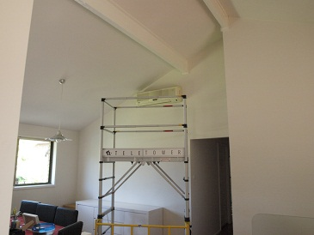
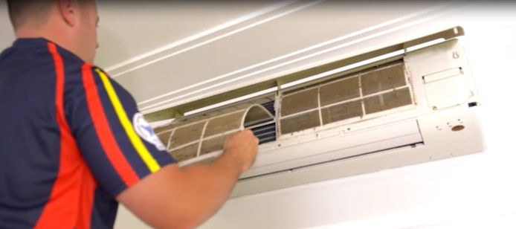
How to Clean Air con units
Internal unit (evaporative)
Inspection
-Set up drop sheet
-Safely set up ladder
-Open the access cover
-Show the customer the visible dirt and build-up

Slide 16
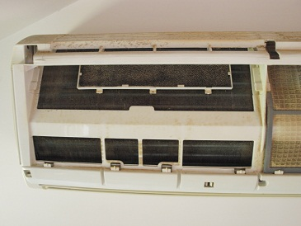
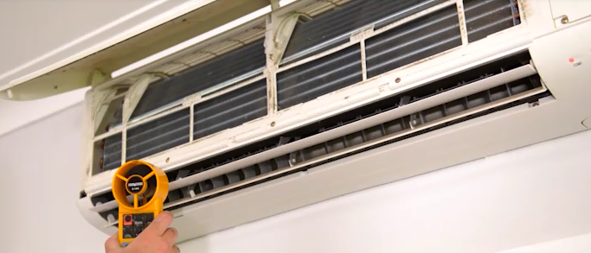
How to Clean Air con units
Internal unit (evaporative)
Take filters out
Use an anemometer to test the air flow and temperature while showing the customer.
Record these figures in your own notes. They don’t need to be left with the customer unless requested

Slide 17
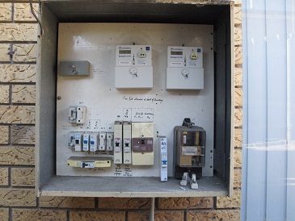
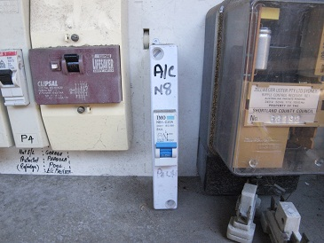
Isolate Power
Work is not to be completed while machine is live
As water is being used around electrical devices the power must be isolated.
Find the separate fuse and switch it off. Red rubber gloves must be worn
Using electrical tape, tape the switch off
Test the machine to confirm the unit is not live. Use the remote or buttons on the device to see if it will turn on

Slide 18
Isolation
If there is not a specified fuse or switch, all power must be turned off. The job can still be done using the fully portable device (one in each city). In this case the customer needs to turn off all the devices in the house. Customer needs to turn off all of their devices

Slide 19
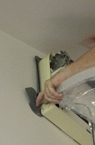
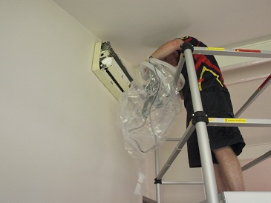
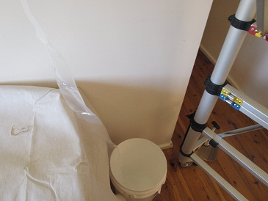
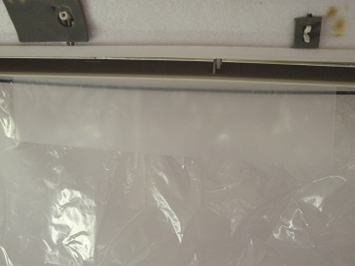
Set-up
Remove cowling
Place grey brackets into the side of the air con unit
Place elastic over the top of the unit
Ensure bags funnel drops into a clean 20L bucket
Ensure plastic plate is in place under the air con as per photo

Slide 20
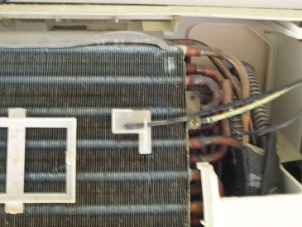
Set-up
Wear safety goggles and face mask
Mix cleaner at 19:1 with hot water (Tap hot water, do not use immersion heater) in solo pump sprayer. That is 50ml of concentrate with 950ml of hot water
Remove thermostat

Slide 21
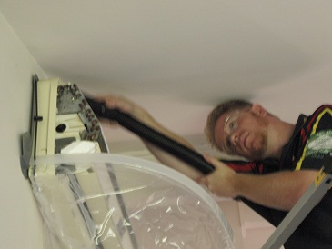
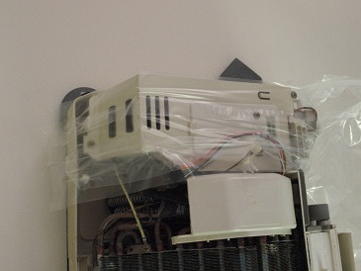
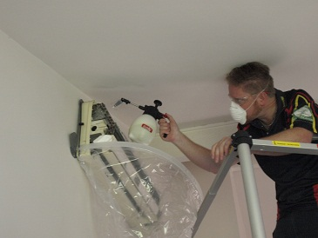
Cleaning
Vacuum electrical area and cover off with non stick tape
Spray down fins with cleaner
Allow dwell time of 10 minutes
Set up Maxi with hot water

Slide 22
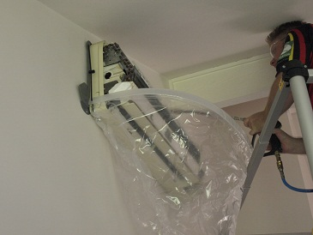
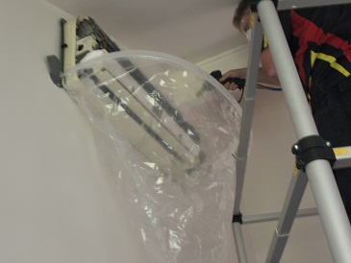
Cleaning
Spray unit down with pressurised hot water
Start at back of unit using 85degree fan jet
Work towards the front of the machine changing to the direct fan jet as soon as possible
Spray into the barrel under the fins where the air is expelled
Wipe down unit as much as possible with white towel

Slide 23
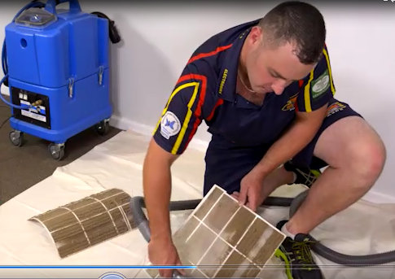
Cleaning filter and cover
Spray with cleaner
Allow dwell time
Using the Sabrina, clean the filters with a hot-water clean.
*Optional* apply EcoProtect to fin unit of condenser (50-60ml of EcoProtect)

Slide 24
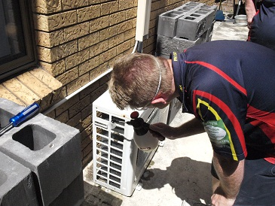
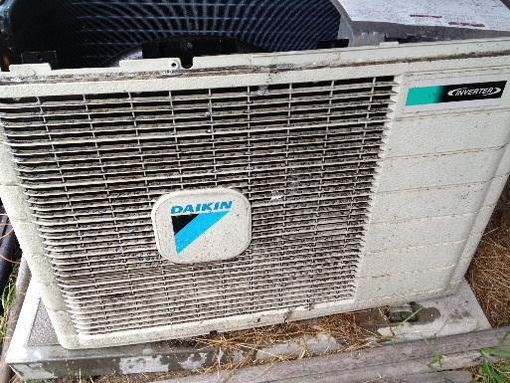
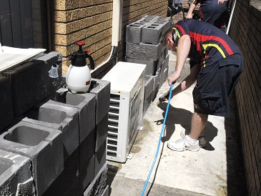
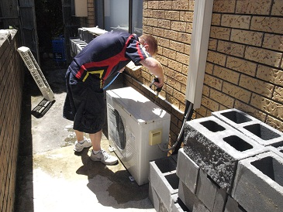
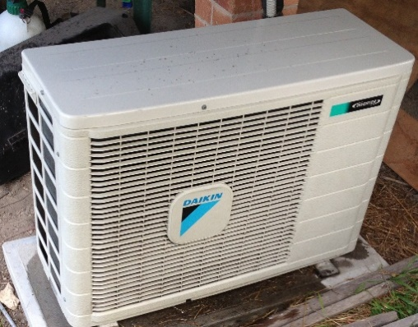
External unit (Condenser)
Place down drop sheet if necessary
Spray outside unit with cleaner with cover on
Spray inside machine onto fans and fin unit
Allow dwell time

Slide 25
External Unit - Condenser
Using Maxi spray down with pressurised water
Allow to dry
*Optional* apply Eco Protect to fin unit of condenser (60-65ml of Eco Protect)
Replace cover if necessary
Tidy and wipe down

Slide 26
External Unit (condenser)
NOTE- sometimes you will be asked to open the condenser unit. Due to age you may not be able to open the condenser cover.
DON’T STRESS.
If this happens you simply need to spray cleaner, water and EcoProtect through the vents.
However this should be found and identified to the customer during pre inspection

Slide 27
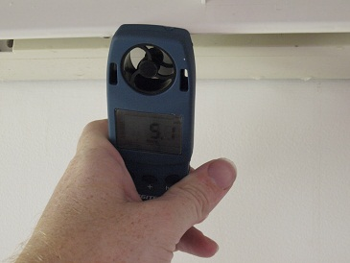
Final inspection
Un-isolate power and turn Air con on
Using anemometer in the same location as at the start of the job, test the air flow and temperature while showing the customer.
Compare these figures to the ones collected at the start of the job
Even if these figures are not different the machine will still deliver a healthier environment

Slide 28
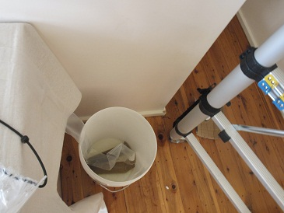
Pack up
Remove bib and bucket.
Show the customer the bucket if they are interested
Replace filters
Clean up and remove all equipment

Slide 29
Probing Questions???
How many units have you got?
Do you have split systems or ducted air con’s
Do your air-con units run on a separate circuit (electricity)?
Is the external unit located on the ground?
Can we reach the internal unit with a step ladder or will need a longer ladder? If a longer ladder is required, we need an approximate height off the ground.

Slide 30
Cleaning Process (script)
Vacuum the unit to remove dirt
Apply a specialised cleaning solution under pressure designed to remove dirt, mould and bacteria.
Clean down the unit and re-install filters and covers
Apart from having cleaner and fresher air, it saves power with improved air conditioner efficiency.
There’s a 14-day guarantee.

Slide 31
Packages
Standard Clean
Internal (Evaporative) unit – clean only
Deluxe clean
Internal and external units – clean only
EcoProect
Additional service that the customer can choose to add to the service

Slide 32
Price points
Split System Unit
Internal (evaporative) unit only $99
Internal and external (evaporator and condenser) unit $149
2nd system onwards – 25% discount.
Ducted System for Small House
6 outlets or less
Internal (evaporative) unit $199
Internal and external (evaporator and condenser) $299
Ducted System for Large House
7 to 12 outlets
Internal (evaporative) unit $299
Internal and external (evaporator and condenser) $399

Slide 33
EcoProtect Pricing
Split system
Internal only $50
Internal and external $70
Ducted system for a small house
Internal $100
Internal and external $140
Ducted system for a large house
Internal $150
Internal and external $200

Slide 34
Heights
Standard - any air con where the bottom of the unit is 2.1meters or lower
Medium - any air con where bottom of the unit is between 2.1 and 2.8 meters. This requires a different ladder that is not in all trucks
High - Any air con where the bottom of the unit is above 2.8 and under 3.8 meters. This incurs a surcharge of $70
Special order- anything over 4 meters, the client must pay all safety equipment. Job is on a quote only basis

Slide 35
Timeframe
Basic split system (one or more units) - 1 hr
Ducted System for a small house – 2 hrs
Ducted system for large house – 2.5 hrs

Slide 36
Ducted systems
If a ducted system has its evaporative unit in the roof, it requires the use of the scaffoldings
This incurs a surcharge of $70
NOTE- in roof ducted evaporative units should be booked in first thing in the morning for WHS reasons as roof cavities can get very hot

Slide 37
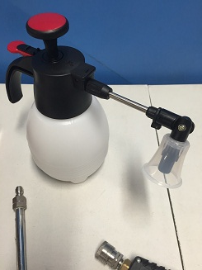
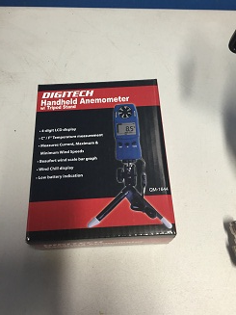
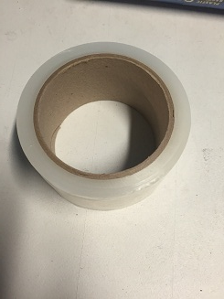
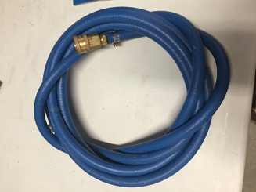
Equipment List
20L bucket
Paint brush
Drop sheet
Safety goggles
Face masks
Work light
Multi tool screw driver
1L Solo pump sprayer
Non Contact tape
Anemometer
Small Sabrina only, requires extension hose

Slide 38
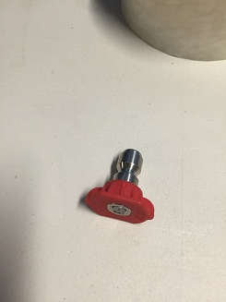
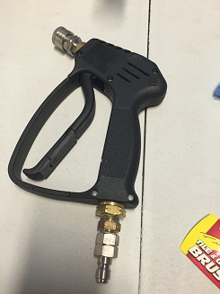
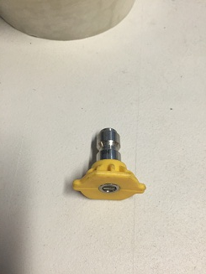
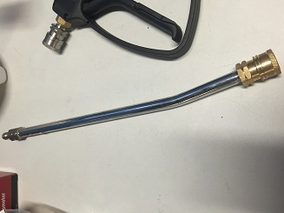
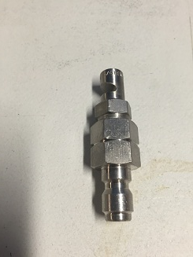
Jet Kit
Jet trigger
Direct Jet
15 degree jet
85 degree angle jet
Extension lance

Slide 39
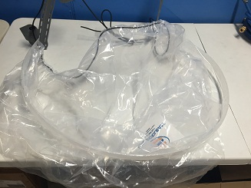
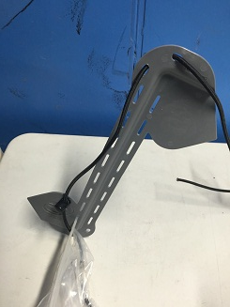
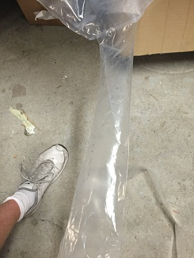
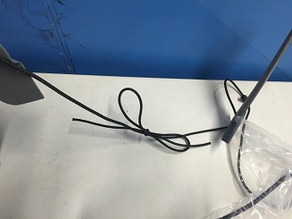
Bib Kit
Bib kit over view
Fitting Bracket
Bib strings
Bib funnel

Slide 40
FAQ’s
Q1:How long the cleaning will last?
A: 3-6 months for a clean and 2 years with ecoprotect but cleaning the air con units every year is best
Q2: Is the cleaning process for each type air con units the same?
A: Yes, but the units being cleaned look a bit different and are bigger.
Q3: Is there a 14-day guarantee
A: Yes
Q4: Is there a discount if there’s more than 1 unit?
A: 25% on the second unit.

