Slide 1
Edry “The cleaning Process”
The Science of Cleaning
Edry Carpet Technician Training
Module 1

Slide 2
Carpet Soiling
Real Soil is defined as any matter that is foreign to the construction of the carpet and which can actually be removed from the carpet, such as sand, grit, hair, food, ashes, etc. This accounts for approx 79% of all soils.
Most soil that accumulates on carpet consists of sand and dry particulate matter. It is often gritty and abrasive.
The remaining soils are generally composed of oils, greases, starches, etc
Most soils are acidic in nature

Slide 3
Soil composition
Type | Composition | Source | %
Insoluble or particle fibres (Dry Soils) | Clay, sand, quartz, gypsum, carbon | Tracked from Exterior | 55%
 | Protein fibre | People, pets, fabrics | 12%
 | Cellulosic matter and fibre | Tracked from Exterior (grass etc), shedding from newspapers, clothes, interior plants | 12%
Subtotal |  |  | 79%
Water Soluble | Sugar, starch, salts, fluid residues | Foodstuffs, body fluids | 6%
Dry Solvent Soluble | Tar, Ashpalt, animal and vegetable oils, vehicle exhaust residues etc | Tracking, cooking vapors, body oil, misc spills of foreign items | 10%
Moisture | Humidity | Outside air, inside activities | 3%
Unknown |  |  | 2%
Total |  |  | 100%

Slide 4
Soil Removal
Particulate and fibrous soils (dirt and fluff) are insoluble and are best removed using a mechanical process – Vacuuming
Particulate soils can be hard to remove because:
  they get trapped in the carpet fibres
  Soils stick to oily residues from cooking, vehicle pollution, food spills etc

Slide 5
The Cleaning Process - Vacuum
The first step in the cleaning process
Use a vacuum with a beater brush and a HEPA filter
  A HEPA filter must remove 99.97% of all particles greater than 0.3 micrometre from the air that passes through.
  The beater brush is required to separate soils from the carpet fibres
An effective vacuum requires airflow. If a bag is full, airflow will be blocked and the bag will be ineffective.
  Always empty the bag when it is two thirds full
Notes:
Explain the a vacuum works by sucking air through the vacuum and it is expelled through the bag, with the bag capturing the soil. If the bag is full then airflow is reduced, markedly reducing the effectiveness of the vacuum. Always replace bags when they’re half full.
Have the trainee pull apart a vacuum and replace the belt and brush to ensure that they understand how to use it properly.

Slide 6
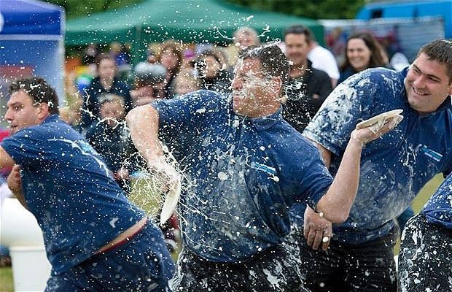
The Cleaning Pie

Slide 7

The Cleaning Pie
“The Cleaning Pie”
Time
Temperature
Chemical
Agitation

Slide 8
TACT – the Cleaning Pie
Four fundamentals of the soil suspension process, together they form the so called “THE CLEANING PIE”.
  Temperature
  Agitation
  Chemical
  Time
If we understand the cleaning pie we get better cleaning results with less effort.

Slide 9
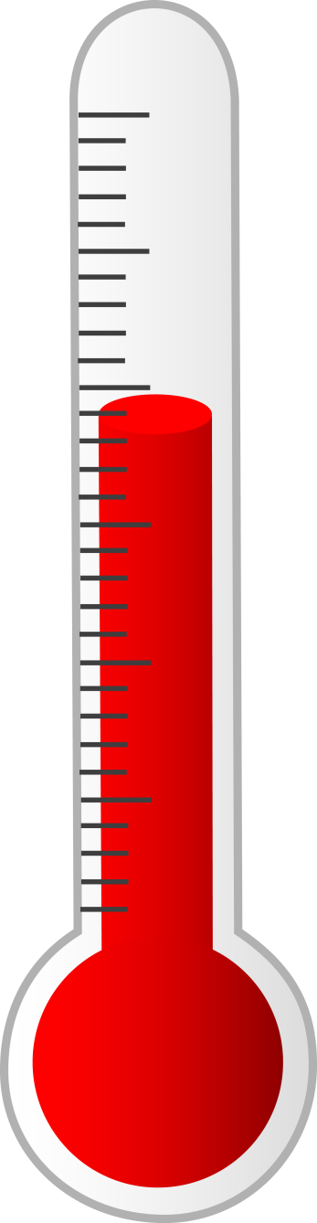
Temperature
The more heat you have, the greater the cleaning power
The molecules in water and chemicals become “excited” as they get hotter
    The hotter they are the more energy they release and the more effective their cleaning power.
Try applying E1 or Prespray hot and see the difference it makes!!

Slide 10
Agitation
Agitation aids in:
  Distribution of chemicals
  Penetration of chemicals into the soils we’re trying to remove
  Assist soil suspension or dislodgement
This is partly achieved through the rotation of the pad from the rotary machine
For better results, agitate in the cleaning chemical with a hot pad or a carpet rake before starting the dry cleaning process

Slide 11

Chemical
Chemicals are used to break down types of soils or contamination
The use of the right chemicals in the right quantity will give the best results
Dwell times are critical
    E1 – short dwell time. Electro Prespray long dwell time
    Electro Prespray has a high pH and should be used as a traffic lane cleaner
    What happens if E1 is over used or under used?
Notes:
Discuss the properties of each cleaning chemical
E1
Short dwell time – ineffective if left on the carpet for longer than 10 mins.
Great at breaking down oily soils.
Use 300 ml per room – 1 container should do 13 – 14 carpet cleaning jobs (average of 4 rooms)
Overuse will leave the carpet stiff and crusty
Pre-spray
Long dwell time
Increase use of E2 to neutralise Prespray
Use sparingly

Slide 12

Time
Time is considered to be an amount of seconds, minutes or hours required for the cleaning agents to provide the optimum effectiveness
This will vary depending on the type of chemical
  E1 has a short dwell time
  Electro Prespray & E8 have a long dwell time
Notes:
Remind technicians that E8 is for not water extraction cleaning only

Slide 13
Rinse/Extraction
Actual removal of soils
Third major step in the cleaning process – the application of chemicals does not remove soil, it just loosens them and breaks down oily residue
Penetration of the cleaning process will depend on a number of factors including
  Density of pile
  Present heat
  Pre-cleaning chemicals
  Rinse chemicals (E2)
Notes:
Use 250ml of E2 per job diluted in 10 litres of water

Slide 14
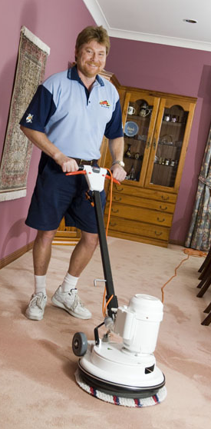
Rinse/Extraction
Extraction process should:
  Remove soils
  Leave the carpet residue free
  Re-set the chemical balance of the carpet (5-6.5)
In the Edry system, oily residues are broken down and soils are captured on the bonnet pads.
  E2 neutralises the cleaning products used re-sets the chemical balance of the carpet
Notes:
Rinse pads before re-use, do not dunk used pads straight back into the solution bucket.

Slide 15
Grooming
Step 4 in the cleaning process
Leave the carpet with a uniform feel
Promotes drying
A dry pad after the cleaning process will also promote drying

Slide 16
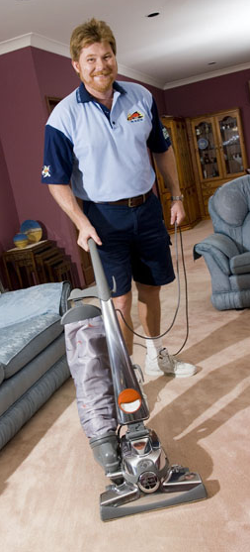
The cleaning process
Step 1
  Pre-vacuum. Mechanical process of removing dry soils
Step 2
  Soil Suspension. The cleaning pie – TACT
Step 3
  Rinse/Extraction. The process of physically removing the soils
Step 4
  Carpet Grooming

Slide 17
The Electrodry System
Step 1 – Thorough pre-vacuum with a Kirby vacuum
Step 2 – Spray the carpet with E1(soil suspension) and Electro Prespray if required
Step 3 – Rinse/Extraction with the dry cleaning system. 250ml of E2 in the rinse bucket will restore the carpets chemical balance
Groom the carpet with a carpet rake

Slide 18
Important Notes
Removing more soil with vacuuming means less soil needs to be removed in the extraction process
TACT tips
  Agitate E1 with a rake in traffic areas
  Use a pad dipped in hot water on the carpet before applying E1 – This will create heat
  Put 200ml of Prespray in a bucket with 5 litres of hot water. Immerse the pad in this solution and run over the traffic areas before cleaning
    This will create heat, high pH & agitation.

Slide 19
Important Notes
Use 2 to 3 pads per room
Each pad should be thoroughly rinsed before putting it back in the E2 rinse solution.
2 to 3 pads is required in any room to effectively extract soils and rinse the carpet.
Use a dry pad to collect excess moisture and promote drying

Slide 20
Pricing
Electrodry’s prices are based on a maximum room size of 13 square metres (3.3*4 metres). If rooms are larger than this, adjust the price:
  Confirm with the customer that they were told that the price is based on a 13 square metre room size
  Measure rooms
  Advised the adjusted price
  If the customer chooses not to go ahead, find a median point with the customer – Do not walk away from the job

Slide 21
Carpet Condition
The price is subject to the condition of the carpet.
  Very dirty carpets charge additional $10 - $20 per room
  Pre-spray and agitate or pre-clean with Prespray
  Use additional pads in the cleaning.
  Ensure the customer gets value for money

Slide 22
Pricing – Specialised Stain Removal
Charge $25 per 15 minutes
Applies to stains that can’t be removed in the cleaning process and require specialised treatment:
  Blood
  Wine
  Make-up
  Heavy grease
  Ink
  Paint
  Urine

Slide 23
Ask for more work
Customers always have more cleaning work that they want done
Look for opportunities
  Other rooms of carpet
  Rugs
  Lounge suites
  Mattresses
Advise the customer how much better the items will look with cleaning and give a price.

Slide 24
Electro 3 Bottles
Professional carpet stain remover
Safe, effective and easy to use
Will generally last for 2 – 3 years with regular use
Show the customer how effective E1 is and advise it’s the same product
$25 per bottle

Slide 25
E-Bac
Deodourises – removes germs, mould and bacteria that causes odours
Encapsulates odour causing oils
Pleasant “re-odourising” fragrances
Effective for 3 – 6 month
Healthguard based product
$1 per square metre

Slide 26
E-Gard
Protective coating over the carpet fibres
Repels against stains and oils
More effective vacuuming – carpets last longer
Healthguard built in to repel germs and mould
Guaranteed for 3 years
$4 per square metre

