Slide 1
Carpet and Fibre Types
Edry Carpet Technician Training
Module 2

Slide 2
Natural Fibres
Wool
  Short fibre
  Absorbs up to 80% of it’s mass in moisture (slow drying)
  May shrink if over-wet
  Very resilient
  Easily absorbs permanent dyes
  Smells when wet – often referred to as a “wet-dog smell”
    This is caused by the sulphur reacting with moisture.
    This can be compounded by moisture in the carpet cleaning activating any mould/yeast present in dirty wool carpet

Slide 3
Natural Fibres
Silk
  Mainly used in rugs
  High lustre
  Very absorbent
  Silk rugs are often subject to dye migration
  Pile can be re-set/distorted through heat
  Affected high alkaline chemicals
  Great care is required when cleaning silk rugs

Slide 4
Natural Fibres
Sisal
  Sisal is a naturally occurring fibre that is obtained from the three-foot leaves of the Agave plant.
  Looks like rope matting
  Used as a durable face yarn
  Will shrink if wet
  Is sometimes dyed a red or green shade. The dye does not hold well and may come off with cleaning
  Many wool carpets are now made to look like a sisal weave and are generically referred to as wool sisal carpets (tight high-low loop pile with a woven effect)

Slide 5
Man Made Fibres
Nylon
  Most common man made fibre
  Long yarn
  Absorbs up to 10% of it’s mass in moisture
  Very resilient
  Can be made as thick or thin as desired and dyed to any colour
  Has dye sites that absorb foreign dyes which can be very hard to remove

Slide 6
The Nylon Generations
"First Generation" Nylon | "Second Generation" Nylon | "Third Generation" Nylon | "Fourth Generation" Nylon | "Fifth Generation" Nylon
Yarns performed well, but magnified soil causing rapid apparent soiling of fibre | Yarns are either delustered or have an altered cross section to improve "soil hiding" ability of the fibre | Yarns have a built-in static control. Since nylon produces very strong static, especially in low humidity situations, it was felt that this development was necessary to facilitate the product’s acceptance in the marketplace. | The Fourth Generation refers to the Nylon that has had fluorochemicals applied to it. Fluorochemicals help to repel soil, oil and water-based stains by lowering the surface energy of the fibres. | Additional properties built into the yarn. The Nylon in the Fifth Generation has been treated with an anionic dye blocker or acid dye resistor to resist stains from common household food and beverage substances. The acid dye resistors act like colourless dyes.

Slide 7
Man Made Fibres - Nylon
5th Generation Nylon
  Has very good stain resistant properties (acid dye blocker and coatings similar to E-Gard)
  Often comes with a stain resistant warranty
  Stain repellancy and dye blockers wear away with traffic and general use
  Any warranties on 5th generation carpets exclude stains created by products such as mustard (disperse dye), hot tea or coffee, blood, vomit, urine, faeces, bleaches, plant food, drain cleaners, non-food substances, non-beverage substances.

Slide 8
Man Made Fibre - Polypropylene
An extrusion dyed fibre – the dye is mixed into the plastic in the manufacturing process. The means there are no dye sites
Predominantly used for commercial carpet and thick rugs
Low moisture absorbency (up to 2%)
Resists bleaching and permanent dyes
Fibres can be re-set with heat. Use of very hot pads can cause a “pad mark”.
Attracts oil and lacks resilience. Tracking can be very hard to remove.
  Requires high ph cleaning products to break down oily soils to successfully clean tracked areas

Slide 9
Man Made Fibres - Acrylic
Acrylic
  Predominantly used in rugs that have an oriental pattern
  Low resilience and susceptible to abrasion
  Becomes more coarse with age

Slide 10
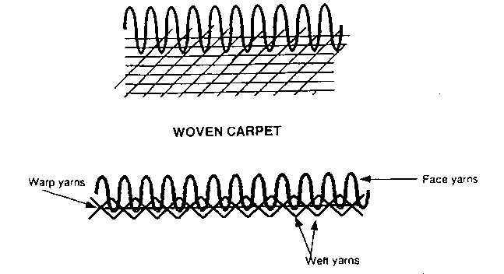
Carpet Style - Woven
‘Woven’ refers to a carpet or rug that is made through the process of weaving. The front and back of the woven carpet are formed at the same time.
Typical woven carpets are Wilton and Axminster.

Slide 11
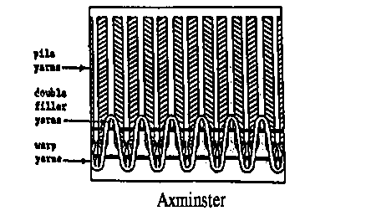
Carpet Style - Woven
Wilton and Axeminster carpets have a wool face yarn and cotton weft yearn (cross yarn)
Long lasting
Regularly used in hotels and clubs given it’s wearability and fire rating

Slide 12
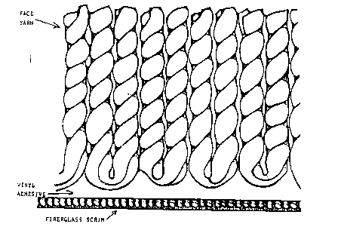
Carpet Styles – Fusion bonded
Fusion bonded carpets are produced by implanting the face yarns directly into a liquid vinyl or rubber that also forms the backing.
It allows the yarns to be more closely packed than in either weaving or tufting processes, resulting in extreme density of fibre.
Fusion bonded carpets can be either cut or looped pile.
Typically used for carpet tiles

Slide 13
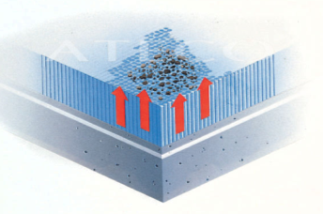
Carpet Styles – Flotex/Walkatex
A fusion bonded carpet
Short fibres are dropped onto a hot liquid which is cooled and sets to become the carpet backing
Non-slip – large areas should be cleaned with hot water extraction
Highly stain resistant

Slide 14
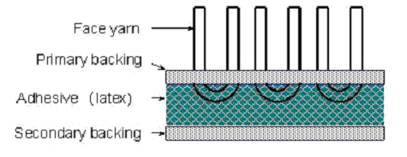
Carpet Styles – Tufted carpet
Most carpets manufactured today are tufted carpets.
In production, yarns are stitched into a backing material to form loop-pile, cut-pile or cut and loop pile carpet.
Tufted carpet construction consists of face yarn and primary backing (usually polypropylene), adhesive (latex glue) and secondary backing (jute or polypropylene).

Slide 15
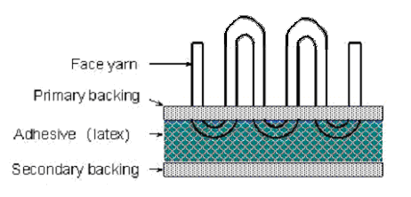
Carpet Styles – Tufted carpet
The production process is
  the face yarn (usually wool, nylon or polypropylene) is sewn into primary backing (usually polypropylene).
  The primary backing is glued to a secondary backing using a latex glue. The secondary backing, usually either jute or polypropylene gives structural strength to the carpet.

Slide 16


Carpet Styles – Tufted carpet
Cut-Pile Design is where the face of the carpet is composed of individual, levelled cut pieces of yarn.
Loop-Pile Design refers to a carpet style where the pile surface consists of uncut loops. The loops can vary in height.
Cut and Loop Pile Designs refer to styles that include elements of both cut and loop pile design.

Slide 17
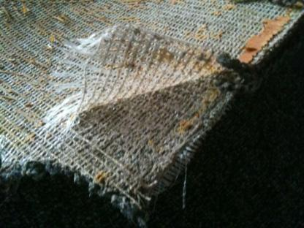
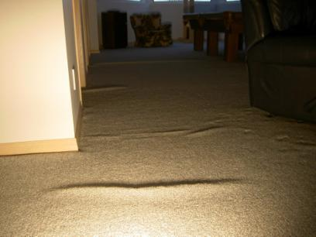
Carpet Issues
Delamination
  When the primary and secondary backing separate. The usually occurs when the latex glue breaks down
  Results in a ripple or wave effect in the carpet

Slide 18
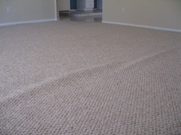
Carpet Issues
Incorrectly layed carpet
  Some carpets are layed without sufficient tension. This is usually because they are layed with a knee kicker instead of a power-stretcher.
  Over time, poorly layed carpet will stretch resulting in a wave or ripple. This usually occurs over the entire width of the room

Slide 19
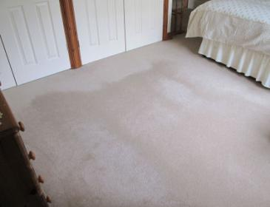
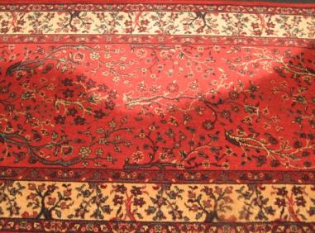
Carpet Issues
Pile reversal/watermarking
  When carpet fibres lean in different directions
  Effect of pile reversal changes depending on the angle at which you look at the carpet

Slide 20
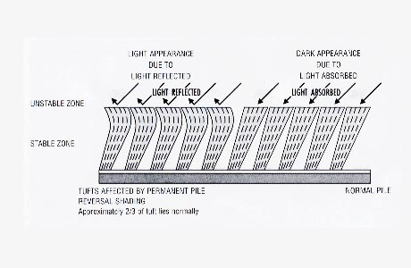
Carpet issues
Pile reversal

Slide 21
Carpet Issues
Abrasion/Wear
  Dull dark areas caused by scratching of the fibres from particulate soils. Will appear to improve when carpet is wet.
  When carpet is worn, the carpet fibres become rough and don’t reflect light resulting in a dark appearance in the carpet. Think Gloss vs. matt finish with paint
  Often accompanied by some permanent staining from soiling
    Photos required

