Slide 1
Edry Upholstery cleaning
Edry Carpet Technician Training
Module 3

Slide 2
Cleaning misconceptions
There are many misconceptions related to upholstery cleaning. It is frequently heard that:
Upholstery is too difficult to clean
It is expensive if we make a mistake
There are too many fabrics on the market so it is better not to touch them
Some fabrics don't clean well, no matter what we do
Some customers can be fanatical about their furnishings and impossible to please.
All the above is true if the upholstery cleaner does not have the required knowledge to do the job.

Slide 3
Equipment required for upholstery cleaning
Kirby vacuum with Zip Brush (Upholstery Tool)
C8 Handmit
Brush (horse grooming brush preferred)
Funnel & Measuring jugs
Bucket
Atomiser spray bottles (500ml and 1 litre bottles)
Clean cloths
Canvass drop cloth
Hot water extraction machine with Upholstery tool
Clean terry towelling cloths

Slide 4
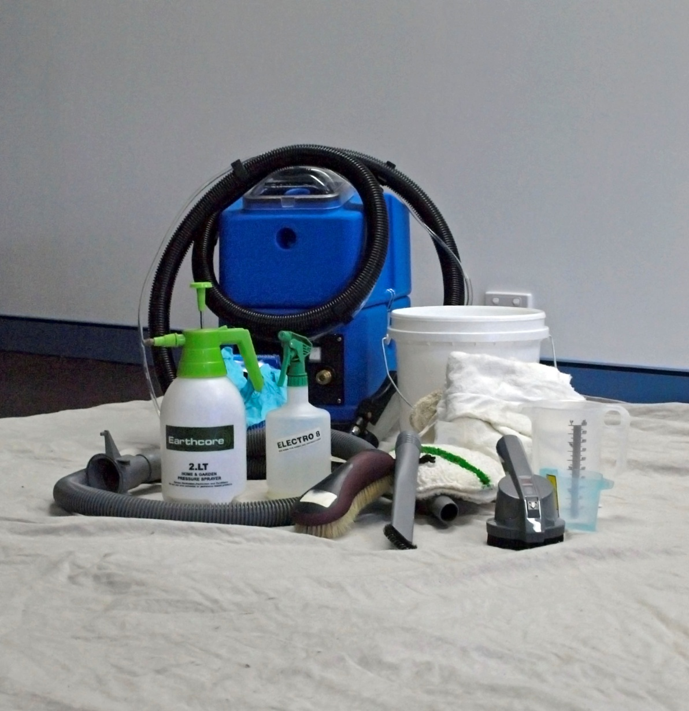
Upholstery cleaning equipment

Slide 5
Fibre types – cotton
grows from the flower and seed of the cotton plant
it is easily dyed and is relatively colourfast
it is a very absorbent fibre and for that reason needs assisted drying
it will withstand high water temperatures
can not be cleaned with high alkaline cleaning agents (pH 10.5+)
it is best cleaned with a neutral cleaning agent (pH 4.5 – 8.5)
can be permanently stained by sweat and soiling
can be subject to browning, which can be prevented by controlling the amount of moisture applied, ph of the chemicals used and rapid drying
a binder present in cotton plants that can dissolve in water based solutions and cause browning is called lignin

Slide 6
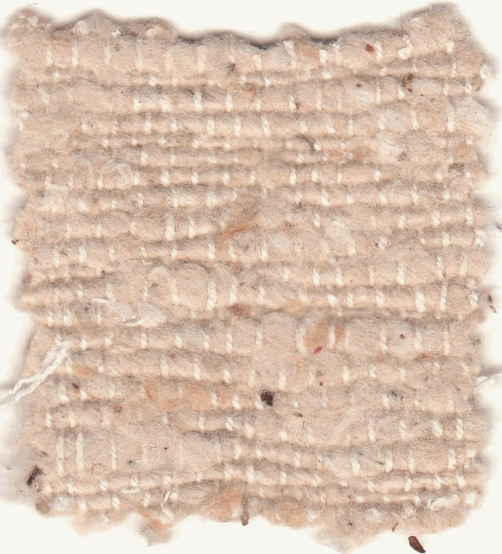
Indian or Haitian cotton
Incompletely ginned (milled) cotton. Still contains some seeds from the cotton plant
Used as a “designer” fabric due to the look of the dark seeds in the fabric.
The brown specks found in these fabrics contain tannin, which is a vegetable dye. Presence of moisture can cause this dye to run, causing intense staining
These fabrics require special treatment and attention both when cleaning and drying.

Slide 7
Fibre types - Wool
Protein/Animal Fibre
it has unique properties of strength, durability and flame resistance
it is absorbent and can hold moisture even though the surface may feel dry
can be damaged by using very hot water or very hot dry solvent
can be easily stained by food acid dyes
Should be cleaned with a product with a pH range of 4.5 to 8.5. If a high pH cleaning product is used then an acid rinse must used to neutralize the cleaning product

Slide 8
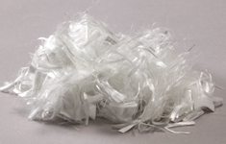
Fibre types - Nylon
nylon is a man made polymer fibre. It is strong and resilient
can be crimped or bulked to give a variety of textures (such as velvet and velour) and can be treated with a variety of finishes to give good stain and soil resistance.
it is easily dyed with acid dyes and is very colourfast
it will withstand very high cleaning temperatures
can be damaged by using high alkaline cleaners (ph10+)
can be stained by sweat and soils but a variety of stain removal treatments can be used
nylon fibres that are not treated with dye blockers are easily stained by food acid dyes such as cordials

Slide 9
Fibre Identification - Polyester
a man-made polymer extruded in molten state.
it is fairly inexpensive
it is not very absorbent to water but is absorbent to oils
it is easily wet cleanable and most soils are readily removed. It also dries fast
can be stained by oils in sweat and other oils due to its oleophilic properties. As the result will yellow with age
dry solvents may need to be used for removal of oils
often used to manufacture microfibre, which is a man made fibre finer than silk. Microfibre is used to make Microsuede and Macrosuede fabrics

Slide 10
Fibre identification – olephine/polypropylene
Olefine is a synthetic, man made polymer fibre. It is also commonly known as polypropylene. It is solution dyed and extruded as a fibre
does not have the strength or resilience of nylon and is usually found in thicker deniers
it is inexpensive and very colourfast
by itself it is often used to make thick and light, open weave fabrics
Extremely low moisture absorbency
Very olephilic – attracts and absorbs oil
Very difficult to stain and easily cleanable
Low melting temperature

Slide 11
Upholstery cleaning systems – on-site dry solvent cleaning
Dry solvents are volatile solvents that totally evaporate
Dry solvent-based solutions are the safest and most effective solution for removing most body oil.
Can be performed in one of 2 steps:
The solvent is sprayed onto the fabric and is immediately wiped or blotted off with a dry piece of white clean towelling. It is a very effective method for quick cleaning. It is also very effective with spotting of already clean or new furniture.
Using a dry solvent extraction machine – (note; ordinary hot water extraction equipment cannot be used with dry solvents). This is essentially the same as hot water extraction cleaning but using an odourless mineral spirit (dry solvent) instead of water.

Slide 12
Upholstery cleaning systems – on-site dry solvent cleaning
Dry solvent cleaning as a stand alone cleaning system is essentially redundant because:
the cleaning process does not remove water soluble soils
The solvent cannot be heated thus reducing cleaning performance
Very expensive due to the cost of solvent and there are potential health hazards due to the odours from the solvent
Solvent can affect many glues or fabric backings.
Dry solvent extraction machines are very expensive and costly to maintain.
It is simply not as effective as wet cleaning

Slide 13
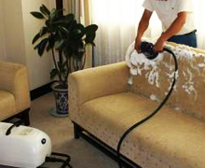
Upholstery cleaning systems – Wet Foam Shampoo
A wet cleaning method using sudsing detergent and agitation followed by wet vacuuming and which leaves fabric relatively damp.
A foaming detergent is agitated into the fabric and extracted with a wet-vacuum
Quick and easy cleaning system however often leaves a residue which causes rapid re-soiling
Minimal cleaning effectiveness
Slow drying time

Slide 14
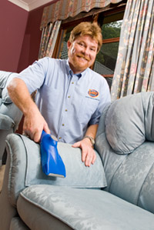
Upholstery cleaning systems -Hot water extraction cleaning
Water is injected into the fabrics and excess cleaning solutions, water and suspended soil is removed through a wet-vacuum
Water injection should occur at 40 to 100 psi of pressure
The use of a detergent pre-spray will allow extra time for soil suspension to occur, which gives a better cleaning result.
Most effective system for heavy soiling
Can be slow drying, promote dye migration and browning

Slide 15
Pre-inspection and testing
The first and most important step in upholstery cleaning
Always pre-test fabrics for colour (dye) stability
In the inspection look for things that could cause problems during or after cleaning such as:
Age, fading and colour loss
Stains and abrasion (wear)
Rips and tears
Metal or wood trims that could cause staining
Anything else that could adversely affect the success of the job. Remember: upholstery fabrics that have excessive soiling may be permanently discoloured or stained.

Slide 16
Pre-inspection and testing
Complete the pre-inspection form on the receipt noting:
The type of stain/damage
Location of the damage
Level of soiling
Other factors such as fading etc

Slide 17
The ph scale

Slide 18
The Ph of cleaning chemicals
Dry Solvents do not contain water so they have no pH
High pH chemicals can cause damage to fabrics. They can:
Unset dyes resulting in dye migration
Promote cellulosic browning
Cause browning to wool fabrics
De-lustre cotton and some synthetic fabrics
E8 has a pH of 8 – in concentrate
Dry-solve has no pH, but can be considered as Neutral
E1 has a pH of 9.5 to 10
Electrodry Prespray has a pH of 10.5 to 11

Slide 19
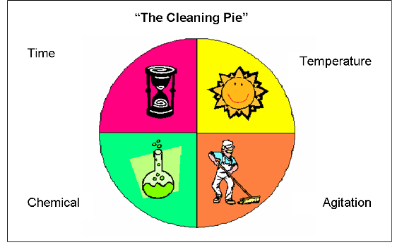
The Chemistry of Cleaning – T.A.C.T. – the cleaning pie

Slide 20
T.a.c.t. – the cleaning pie
Time – the required dwell for chemicals to be most effective. Some chemicals require no dwell time and others 15 to 20 minutes
Agitation – Helps distribute cleaning products and loosens soils for extraction. Can occur in the pre-treating and cleaning process
Chemical – the choice of the correct chemical for the type of fabric and the cleaning process. Determination should be subject to the type and level of soiling
Temperature – Heat is one of the most important factors in cleaning. The hotter the temperature the better the cleaning result.
NB: High temperature will damage some fabrics

Slide 21
The Chemistry of Cleaning – T.A.C.T. – the cleaning pie
Soil is made up of three basic categories:
Dry soils
Water-soluble soils
Oils and fats
Dry soils will vacuum out. Water soluble soils will rinse out. Oils and fats must be dissolved or turned into a solution, emulsion or suspension before they can be extracted out.

Slide 22
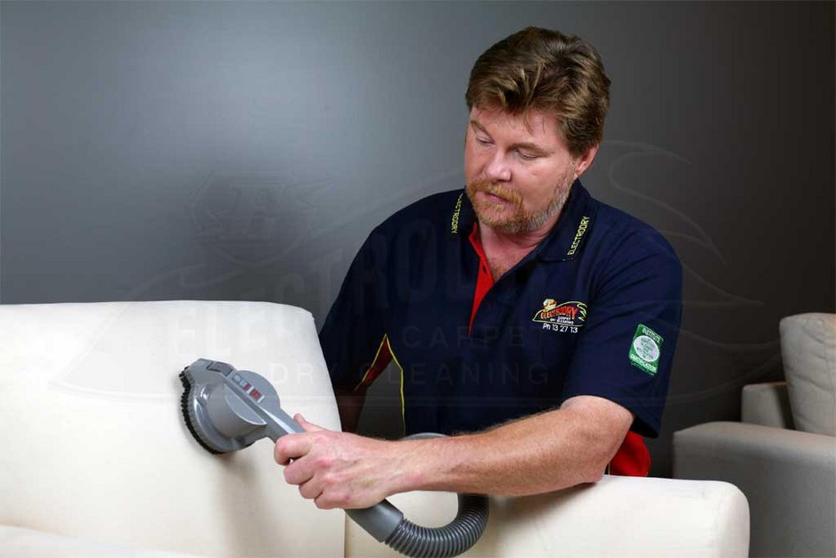
The cleaning Process – step 1, vacuum
Follows the pre-inspection
A dry vacuum is required to remove the dry soils
If dry soils are mixed with water in the hot water extraction process, they absorb water becoming heavy as they turn to mud. As mud, soils are much harder to remove.

Slide 23
Step 2 – Removal of oily soils
Oily soils are best broken down with dry cleaning solvents
Dry cleaning solvents are most effective at breaking down the oily soils that accumulate from body and hair oils that commonly soil upholstery
Apply Drysolve E using an atomizer spray. Agitate and wipe off with a C8 hand-mit
Drysolve E will not cause colour run and will totally evaporate

Slide 24
Step 3 – Soil Suspension
Apply E8 to the lounge suite at a dilution of 15:1
Agitate into the fabric with a soft brush. This will help distribute the chemical and loosen soils
Allow a dwell time of at least 10 to 20 mins before commencing extraction
E8 will encapsulate (surround) the soil allowing for easier removal of the soil from the fabric
E8 also contains Healthguard to “knock down” present mould and germs.
If spot cleaning is required during the cleaning process for synthetic fabrics, use E1in small amounts.

Slide 25
Step 4 – Hot water Extraction
Hot water extraction cleaning should be completed at 40 to 100 psi of pressure.
Water should be 60 to 70 degrees celsisus in temperature. Slightly hotter than “tap hot” hot water is desirable.
Employ a 50% overlap on each pass and undertake a “dry pass” afterwards.
“Towel down” the fabric with a clean white towel after cleaning to promote drying.
Use a fan where possible to promote drying – most clients have a pedestal fan that can be very effective to promote drying.

Slide 26
Drying
To expedite drying
Minimise water use.
Using the right cleaning products and agitating the cleaning products on application will improve cleaning performance, reducing the water required for cleaning.
Use hot water (not boiling water as this will affect the upholstery cleaning machine)
Stack cushions to allow maximum airflow
Use a fan
Ask the customer for a pedestal fan
Increase airflow
Open windows or turn on the air conditioner

