Slide 1
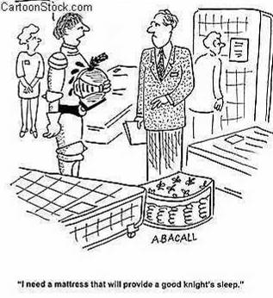
Mattress Cleaning

Slide 2
Mattress Cleaning Home Solutions
Today you will be learning the Electrodry process of cleaning mattresses
The Healthy Mattress Solution – For cleaning a typical mattress.
The Deluxe Mattress Solution –To decontaminate and sanitise a soiled mattress

Slide 3
Why Clean your Mattress?
The average person loses 1.5 cups of water per night (from perspiration)
Mattresses provide an environment for dustmites & bacteria to harbour due to the ideal conditions.
The food source that is provided for dust mites is mainly exfoliated dead skin which leads to bacteria growth.
Our Restezy product ‘Healthy Mattress Cleaning Solution’ has a lavender scent which has been proven with a calming effect to human minds.
RESTEZY = SLEEP EZY!

Slide 4
The Healthy Mattress Solution
The Healthy Mattress Service -
Kills dust mites, viruses, bacteria, fungi and germs
Treats “yellow staining” of mattresses and pillows
Removes dead skin and dust mite faeces

Slide 5
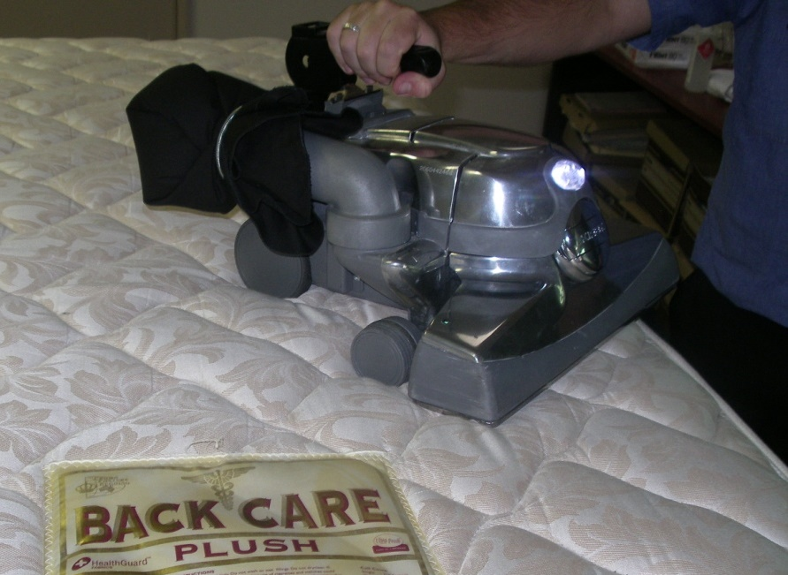
The Healthy Mattress Solution
Sell the service! Suggest to the customer that you vacuum the mattress as a quick example of what is present.
Demonstrate using a black display cloth vacuum a small area of the mattress with several passes
Show the matter collected in the display cloth to the client.

Slide 6
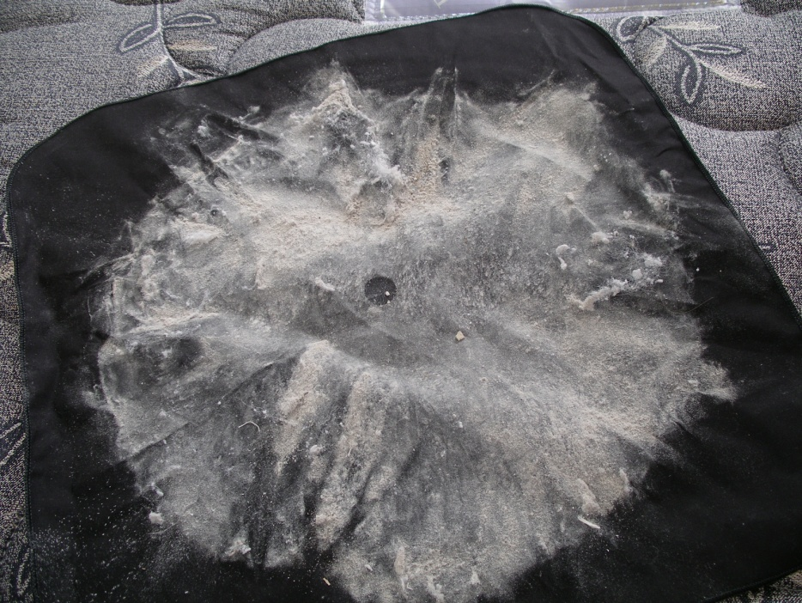
The Healthy Mattress Solution
This part of the process is very important as it displays to the client the quantity of dead skin and other matter that the cleaning process will remove. Yellow, greenish and brownish tinges show evidence of active moulds

Slide 7
The Healthy Mattress Solution
Undertake a thorough pre-inspection of the mattress and pillows to ensure the mattress can be cleaned and treated and that the results will match the clients expectations. Ensure that you check both top and bottom of the mattress for excessive staining during this process.

Slide 8
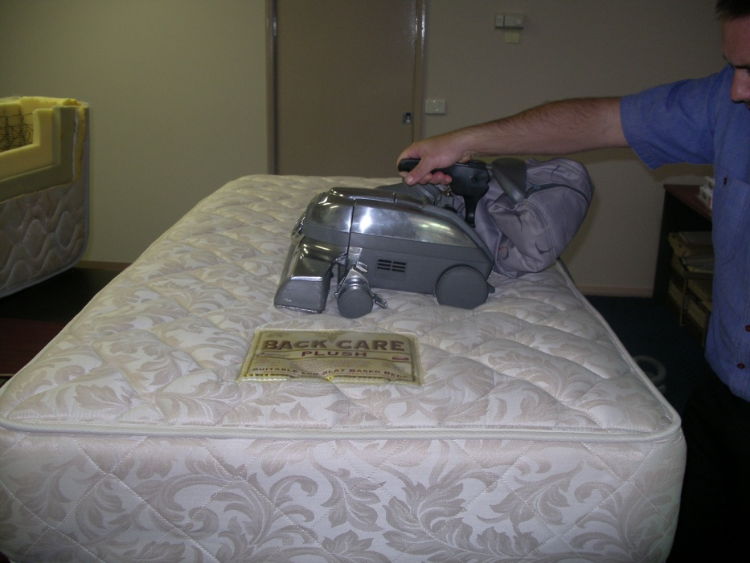
The Healthy Mattress Solution
Vacuum the mattress and pillows with a Kirby Vacuum with a new HEPA filter bag. Vacuum the top, bottom and all 4 sides of the mattress and each pillow in slow even stokes ensuring you pass over each area of the mattress twice in both directions (4 passes in total).

Slide 9
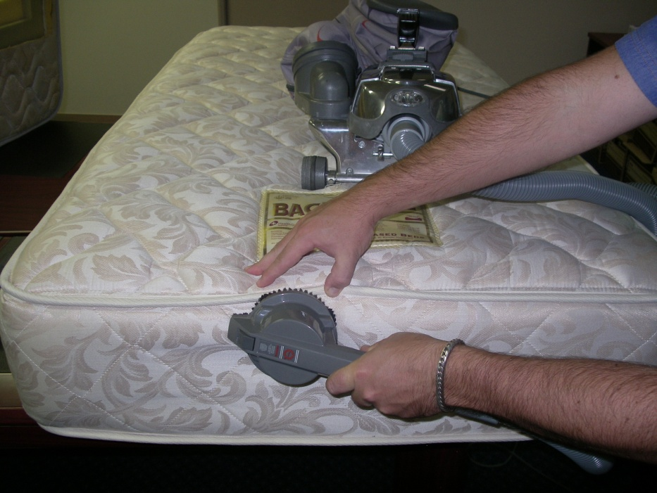
The Healthy Mattress Solution
Pay particular attention to the ticking/piping where thorough vacuuming is required. This whole process should take 8 to 12 minutes.

Slide 10
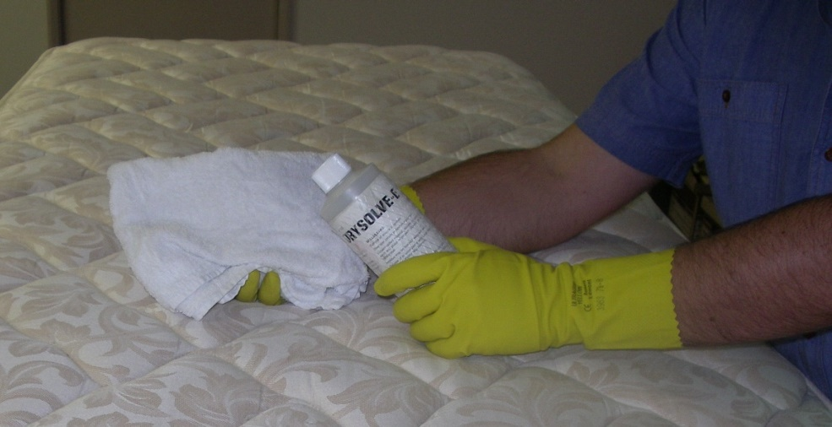
The Healthy Mattress Solution
Wipe over the areas of the mattress affected by body sweat with Drysolve-E on a clean white rag. This will remove a large amount of the body oils on the mattress.

Slide 11
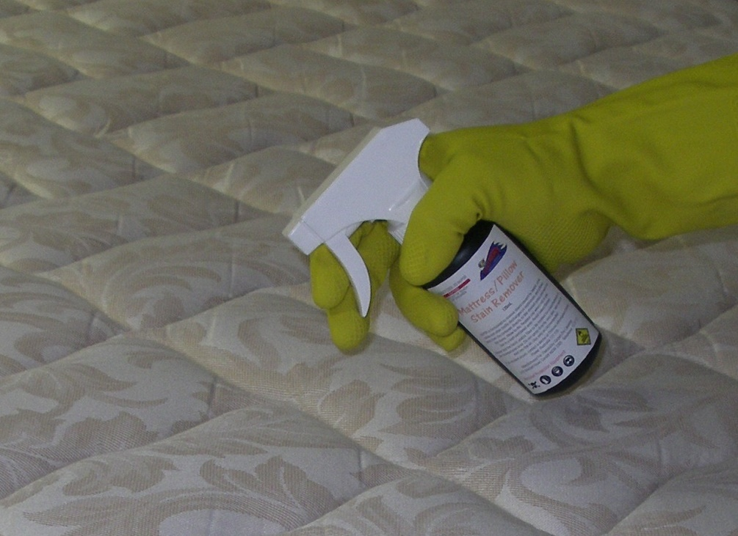
The Healthy Mattress Solution
Apply mattress stain remover to mattress and pillows as required. This product is an oxidizing product that will remove or substantially lighten any yellow stains that have built up on the mattress or pillows over a period of time. For fastest and best results expose the treated areas of the pillow and mattress to UV light after treatment. Use only a small amount of this product and wipe off
Do not use on mattresses with a plush pile

Slide 12
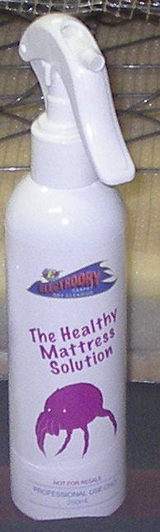
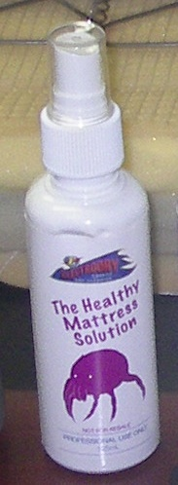
The Healthy Mattress Solution
Apply The Healthy Mattress Solution to the mattress per directions on the container to the mattress and pillows. Use the entire bottle of The Healthy mattress solution … this is specifically measured dose. Allow to dry. Do not towel off.
Single Mattress
Double Mattress

Slide 13
The Healthy Mattress Solution
Pricing Schedule for Healthy Mattress Service
Single Mattress $70
Double Mattress $85
Queen Mattress $105
King Mattress $125
This pricing includes the application of the healthy mattress solution and the mattress and pillow stain remover.

Slide 14
The Deluxe Mattress Clean

Slide 15
The Deluxe Mattress Service
The Deluxe Mattress Service -
Include the benefits of the Healthy Mattress Solution
Remove urine decontamination and odours
Removes urine stains
Removes other contamination such as blood etc.

Slide 16
The Deluxe Mattress Service
Undertake a thorough pre-inspection of the mattress and pillows to ensure the mattress can be cleaned and treated and that the results will match the clients expectations. Ensure that you check both top and bottom of the mattress during this process.
Perform a colourfast test to ensure that colour will not run from the mattress fabric.

Slide 17
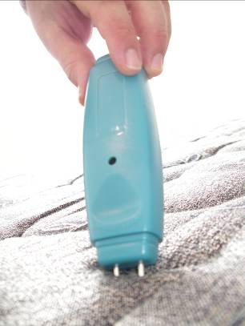
The Deluxe Mattress Service
Identify any areas of the mattress that have been effected by urine (this will be done by sight, smell and with the use of “wet-check” or “hydrosensor”)

Slide 18
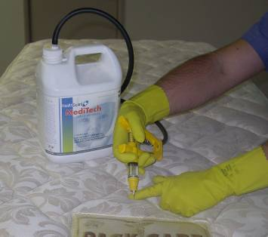
The Deluxe Mattress Service
Inject 5 ml of Meditech into the stain per 5 centimetre square area that is effected by the urine.
This process is designed to kill the bacteria, neutralize the urine and remove the odour in the mattress that is associated with the urine. This process will only be successful for mild contamination.

Slide 19
The Deluxe Mattress Service
Treat the mattress for any blood stains or other contamination stains at this point in time.

Slide 20
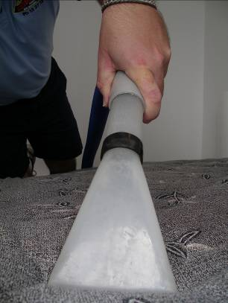
The Deluxe Mattress Service
Perform a wet-clean of contaminated areas of the mattress at 50 p.s.i. using tap warm water and towel off. If there have been contaminants from bodily fluid then treat the mattress with Meditech.

Slide 21
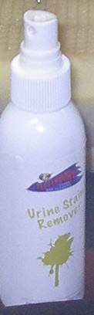
The Deluxe Mattress Service
Apply UST to any urine stains. This product should be sprayed directly onto the stains.
UST is an oxidizing stain removing product and will be effective over a period of time. Do not expose areas treated by UST to UV light.
Always apply oxidisers after a wet clean, not before.

Slide 22
The Deluxe Mattress Solution
Apply The Healthy Mattress Solution to the mattress per directions on the container to the mattress and pillows. Use the entire bottle of The Healthy mattress solution … this is specifically measured dose. Allow to dry. Do not towel off.
Always apply oxidisers after a wet clean, not before.
Single Mattress
Double Mattress

Slide 23
The Deluxe Mattress Solution
Apply mattress stain remover to mattress and pillows as required. This product is an oxidising product that will remove or substantially lighten any yellow stains that have built up on the mattress or pillows over a period of time. For fastest and best results expose the treated areas of the pillow and mattress to UV light after treatment.
Apply sparingly – a maximum of 2 sprays per area

Slide 24
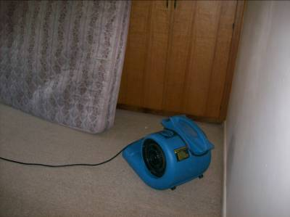
The Deluxe Mattress Service
Use an airmover on low speed to dry the mattress for as long as possible before leaving the premises.

Slide 25
The Deluxe Mattress Service
Important Notes:
The wet-clean is only necessary in the case of urine stains or the treatment of urine, blood or other contaminants.

Slide 26
The Deluxe Mattress Service
Pricing Schedule for the Deluxe Mattress Service
Single Mattress $90
Double Mattress $115
Queen Mattress $145
King Mattress $170
This pricing includes the urine stain treatment, application including injection of Meditech, the application of the healthy mattress solution and the mattress and pillow stain remover.

Slide 27
Questions and Concerns

