Slide 1
Work place Health & Safety
Hazardous Chemicals
Notes:
Work place Health & Safety - Hazardous Chemicals

Slide 2



Notes:
WHS is about thinking before you do. It is safety for Life at Home Work and Play

Slide 3
Work place Health & Safety
Notes:
Issue and walk through Electrodry WHS Policy

Slide 4
Work Place Health & Safety
What does WHS stand for ?
Work place Health & Safety
Has it always been WHS ?
NO – It used to be known as OHS
(Occupational Health and Safety).
The change happened as of the 1st of January 2012
The reason for the change ?
To have a Nationally Uniform Compliance and Enforcement Policy throughout Australia .
So every worker is covered and treated the same across Australia .
To Protect the Health and Safety of all workers .

Slide 5
Work place Health & Safety Hazardous Chemicals
Within this module we will be covering
Hazardous Substances Register Index
SDS Folders
Record of Risk Assessment for a Hazardous Substance
PPE –Personal Protection Equipment
Notes:
Ask the guys to open up there SDS folder

Slide 6
Hazardous Substance Register
A Hazardous Substance Register has the following information .
Name of the substance
The supplier
Hazardous Yes ( Y ) or No ( N )
SDS (MSDS) issued date
Risk assessment .
It is found at the front of your SDS Folder
Notes:
When you have gone through the SDS and “ What is a Hazardous Substance Register “ it will then be time to go over the whole Hazardous Substance Register index item by item and on the ones that are hazardous go to the SDS and explain to the techs what they need to do to be safe .

Slide 7
Safety Data Sheets (MSDS)
What is a SDS (MSDS)
SDS (MSDS) stands for Safety Data Sheets (MSDS) is Material Safety Data Sheets .
MSDS is being replaced with SDS but there is no real major change to the sheets or there information.
Safety Data Sheet is a document that provides information on the hazardous chemicals and how they affect health and safety in the workplace .
SDS includes information on :
The identity of the chemical
Health and physicochemical hazards
Safe handling and storage procedures
Emergency procedures and
Disposal considerations .

Slide 8
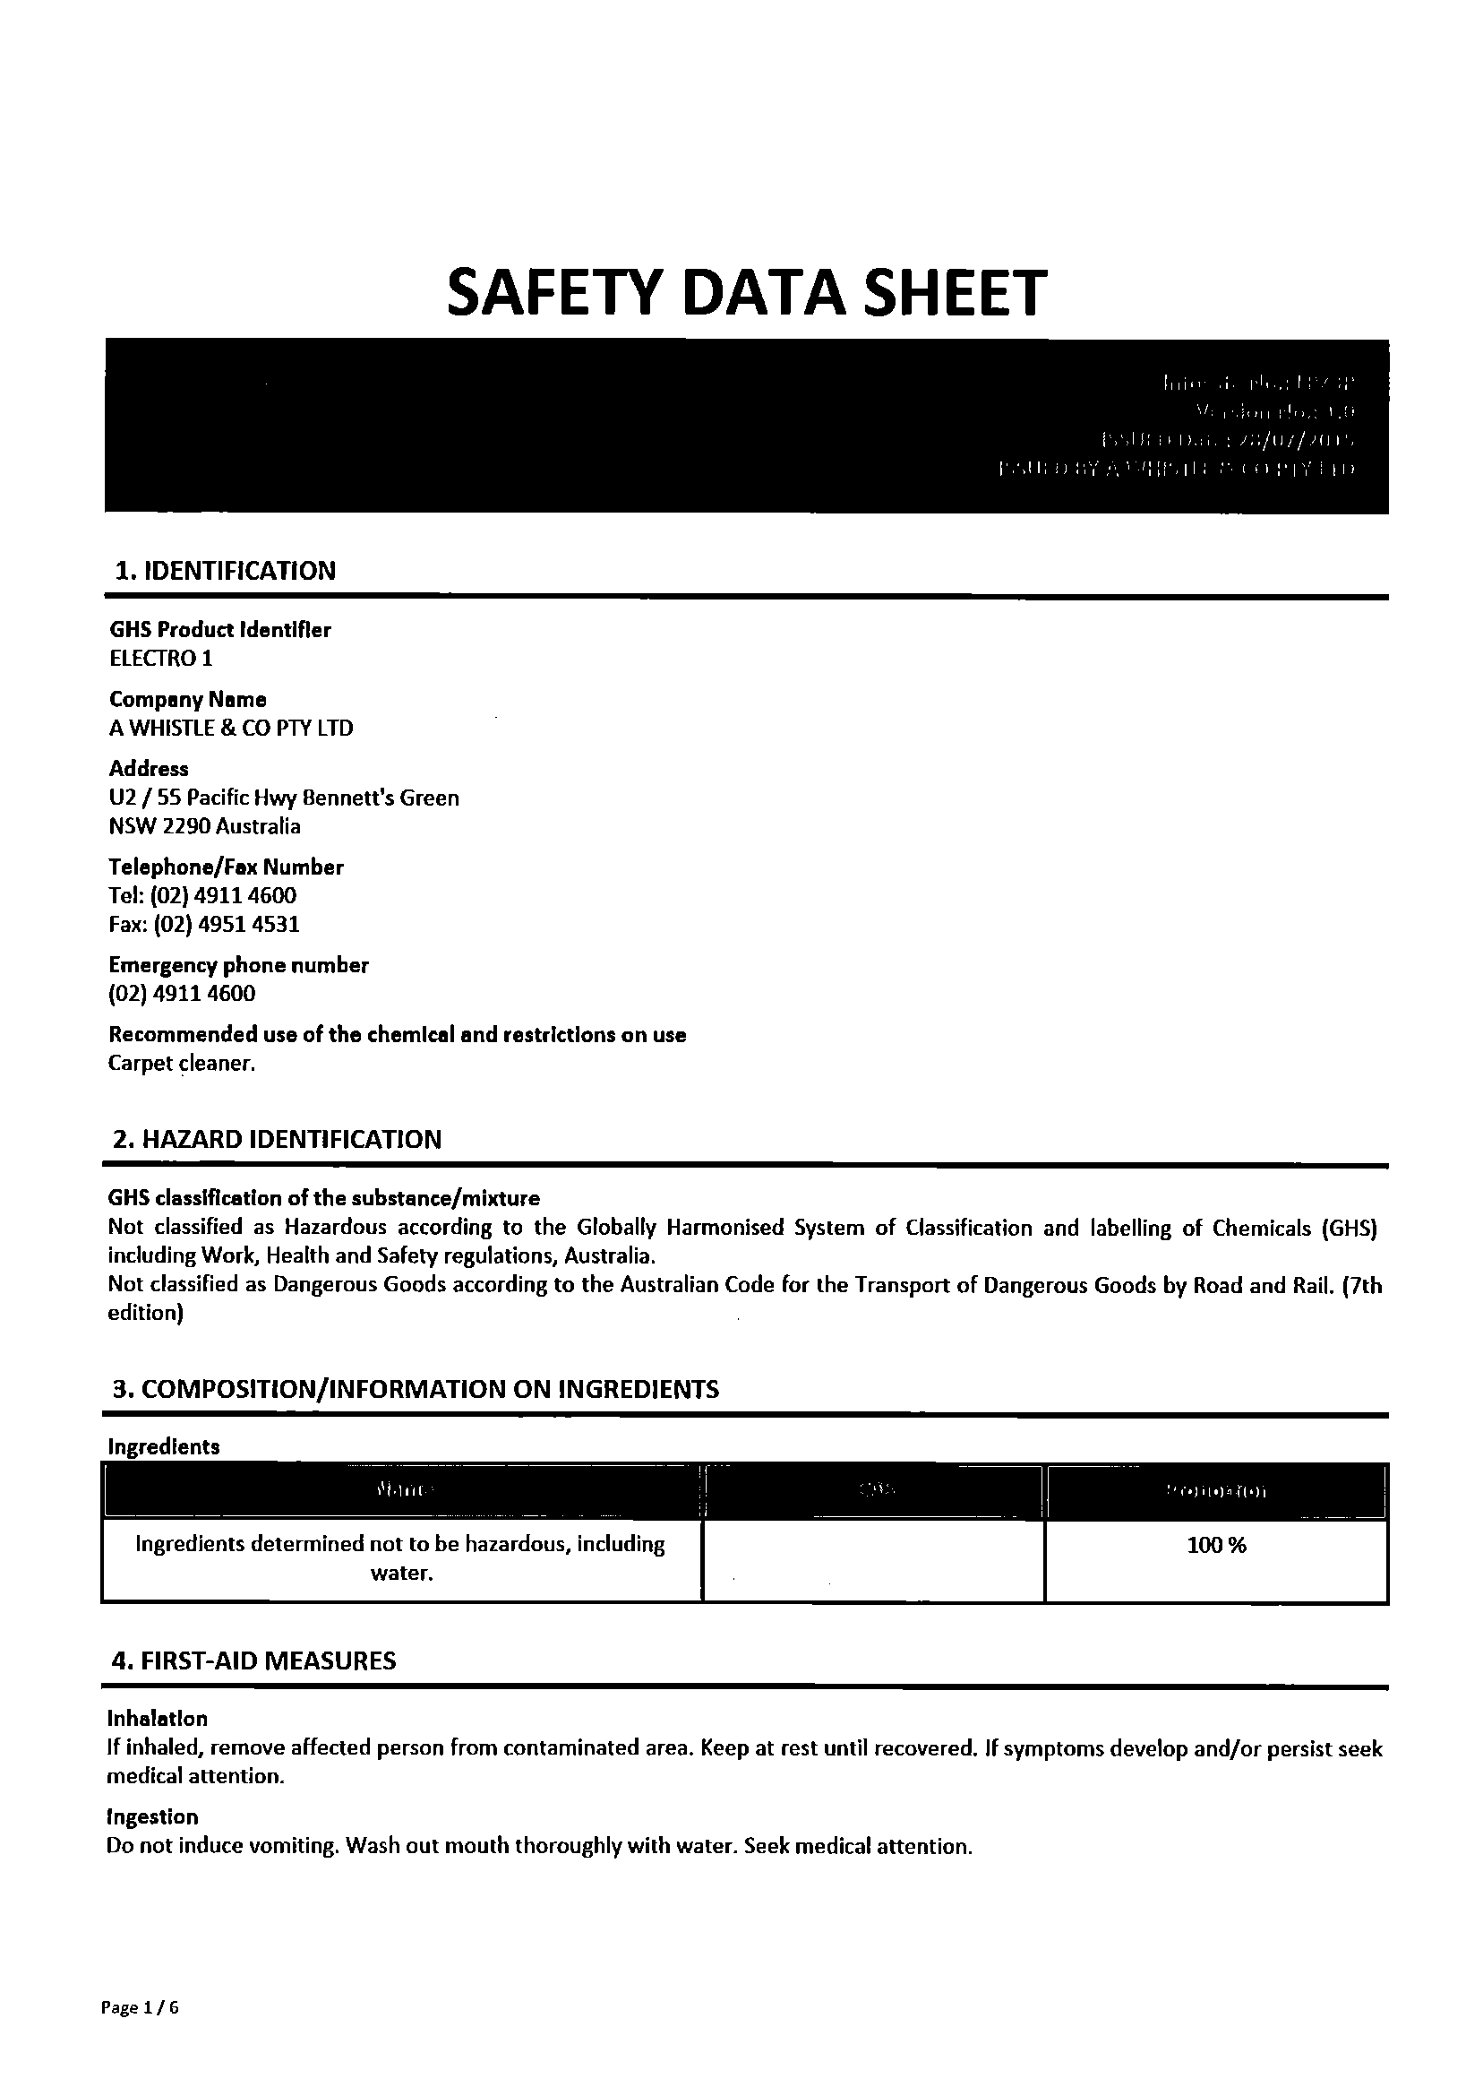
This is an SDS for E1
Notes:
Get the tech’s to open there SDS folders and go through one of them so that they understand it .

Slide 9
SDS (Safety Data Sheet) Folders
These folders must be kept in the following areas
Drivers cabin of all vans . These folders will have all the SDS in them as well as the Hazardous Substances Register which list all the hazardous and non-hazardous chemical’s .
Depot’s, storage sheds and home storage areas must also have folders . These folders will also have SDS / MSDS , Hazardous Substances Register and will also have Record of Risk Assessment for a Hazardous Substance .
SDS / MSDS have a life of 5 years from date of issued .
Notes:
It would be a good idea to check the SDS / MSDS from time to time to make sure all your sheet’s are currant .

Slide 10

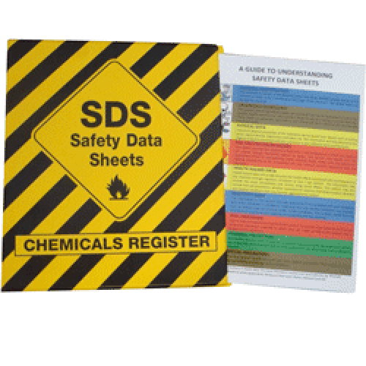

Notes:
Get

Slide 11
Record of Risk Assessment for a Hazardous Substance
Record of Risk Assessment has the following information .
Name of hazardous substance
How and what it is used for
Who it is used by
Nature of hazard
Possible types of exposure
Controls , PPE and measures needed
Level of risk .

Slide 13
WHS also covers PPE .
PPE stands for Personal Protection Equipment some of which is listed below .
Hand protection – gloves
Respiratory protection – full face respirator with filters .
Eye protection – safety goggles / glasses
Body protection – chemical resistant disposable overalls.

